Slide 1

Exploratory Data Analysis of Movies released 2006-2016

Slide 2
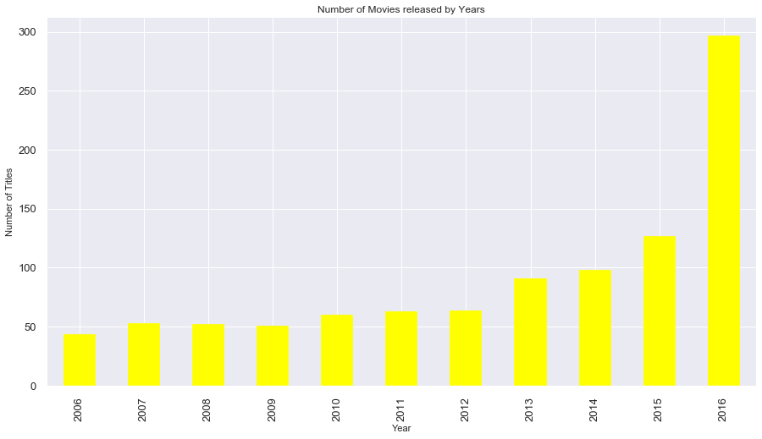
Number of movies released over the years
The number of movies releasing per year have increased significantly over the years

Slide 3
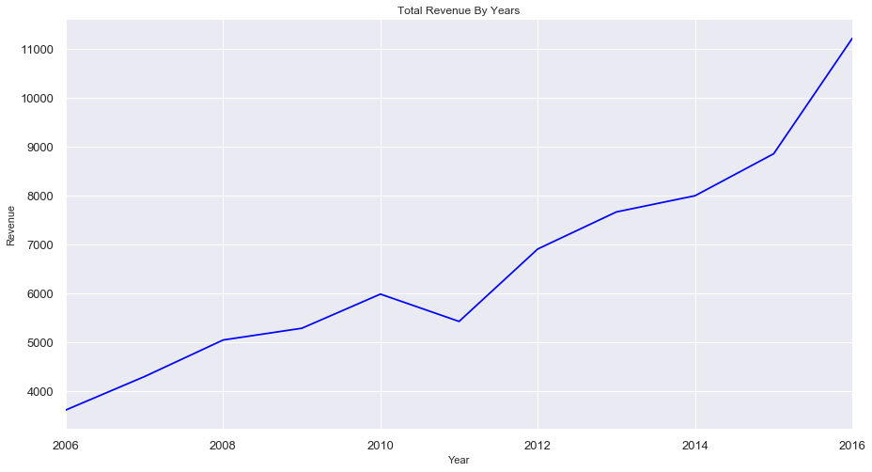
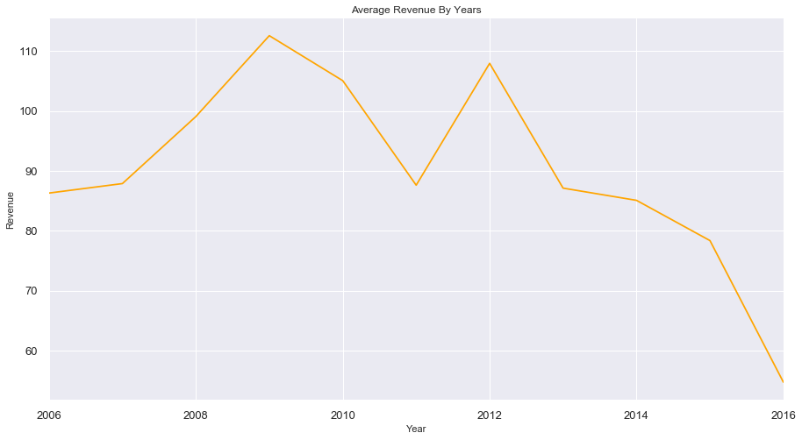
Impact of increase in number of movies
Total revenue increased
Average revenue decreased

Slide 4
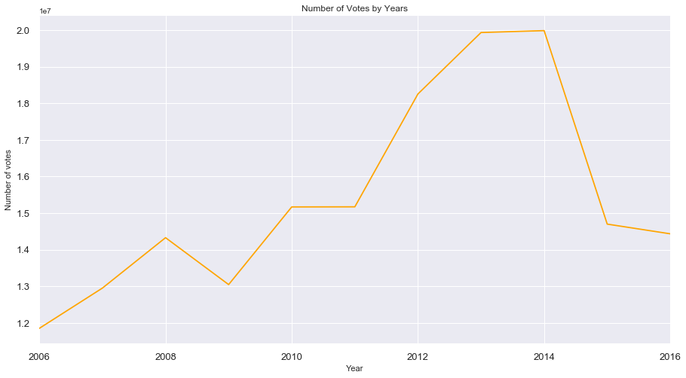
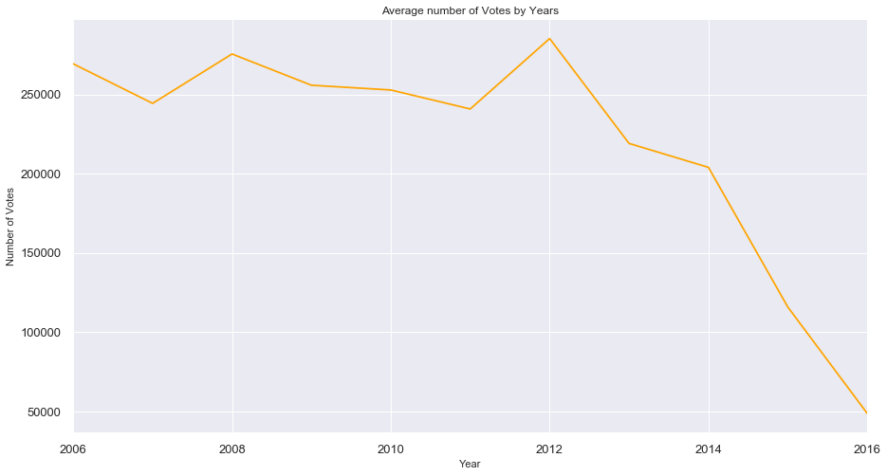
Impact of increase in number of movies
Total viewers votes increased
Average viewers votes decreased

Slide 5
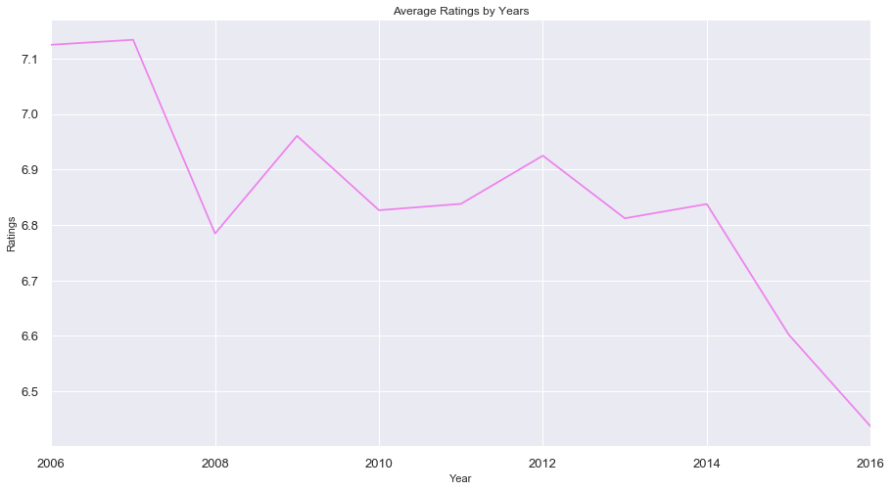
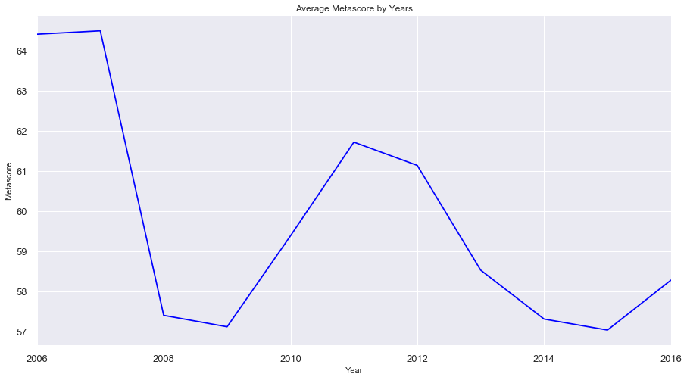
Impact of increase in number of movies
Ratings decreased over the years
Metascores decreased over the years

Slide 6
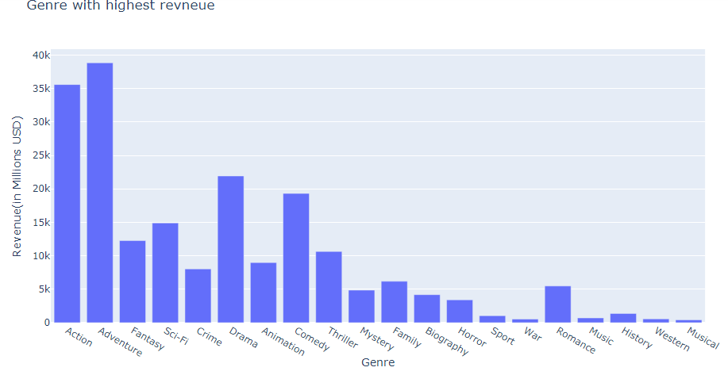
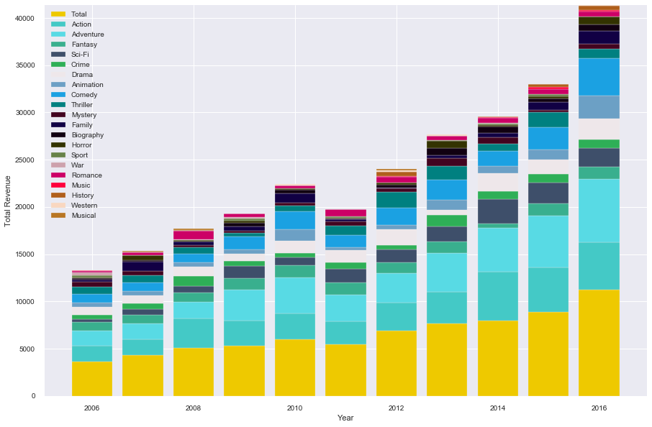
Genre generating maximum revenue
Total revenue by each genre
Revenue by genre year-wise

Slide 7
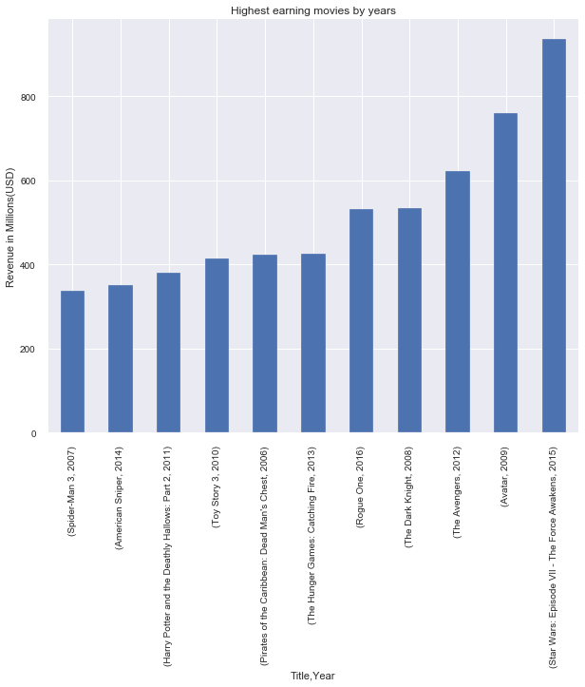

Revenue and Ratings
Highest earning movies
Highest rated movies

Slide 8
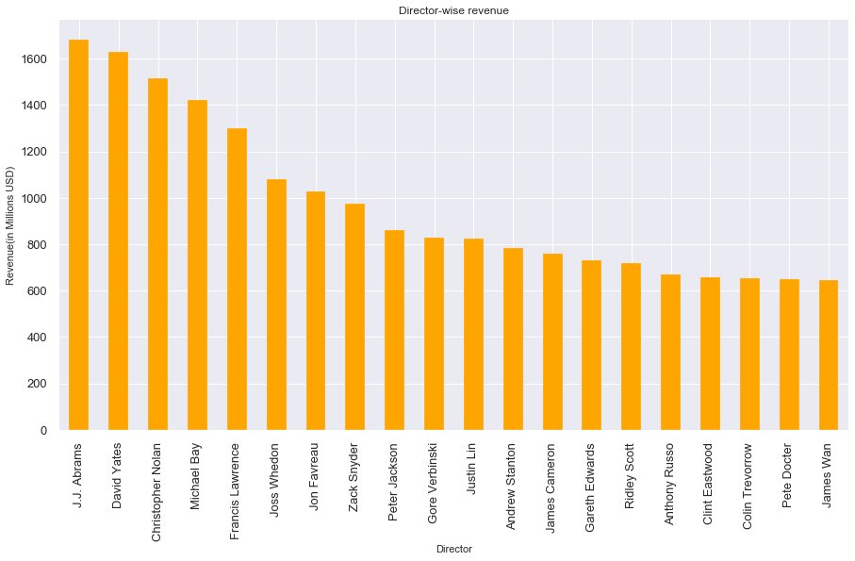

Revenue and Ratings
Directors with highest earning movies
Directors with highest rated movies

